Slide 1
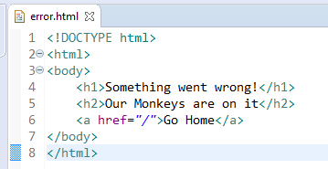
Spring Boot - Displaying Custom Error Pages
We first need to create a custom HTML error page.
We’ll save the file as error.html since we’re using Thymeleaf template engine.
If we save this file in resources/templates directory, it’ll automatically be picked up by the default Spring Boot’s BasicErrorController.

